Slide 1



Slide 2
“MECHANICALLY"
Computing Department, FCIT
Group Members:
Muhammad Taha Qadri (1197-2020)
Muneeb Shahid (1437-2020)
Muhammad Hannan Faisal(961-2020)
Supervisor Name :
Miss Shagufta Aftab
Co-Supervisor Name :
Sir Talha

Slide 3
Table of Content
Introduction
Problem Statement
Sustainable development goals
Screenshot of Mechanically Mobile App
Future Work

Slide 4
Introduction
In an era marked by technological acceleration and urban dynamism, the "Mechanically" project emerges as a pivotal response to the escalating demand for streamlined roadside assistance. The traditional models of emergency services face challenges in meeting the evolving needs of a rapidly changing urban environment. In this context, the "Mechanically" project aspires to leverage cutting-edge technology to enhance the roadside assistance experience for the citizens of our city.
This report delves into the intricacies of the "Mechanically" project, which aims to create a comprehensive and user-centric platform. By drawing inspiration from various innovative projects worldwide, we explore key elements and features that contribute to the efficient provision of services for vehicle breakdowns. The integration of technology, communication, and user-friendly interfaces becomes paramount in addressing the challenges associated with traditional emergency services.
As we navigate through the report, we will unravel the project's conceptualization, design considerations, system architecture, and strategic decisions. By understanding the core components and methodologies employed in the development of "Mechanically," this report aims to provide insights into how modern technology can be harnessed to offer swift and effective roadside assistance. Ultimately, the "Mechanically" project stands as a testament to the potential of technology to reshape and elevate the standards of emergency vehicle services in our city.

Slide 5
Problem Statement
The city of Karachi, Pakistan faces a major issue of frequent vehicle failures, causing inconvenience and disruptions for its residents. To address this problem, we are trying to develop an application. The application aims to connect users with nearby mechanics using location-based services, there by saving time and reducing the inconvenience caused by vehicle breakdowns. The goal is to provide a convenient platform that eliminates the need for manual searches and enables users to make informed decisions based on ratings, reviews, and chat assistance. The application seeks to improve the vehicle repair experience for residents of Karachi by offering a reliable and efficient solution to their vehicle-related problems.

Slide 6




Sustainable Development Goals

Slide 7
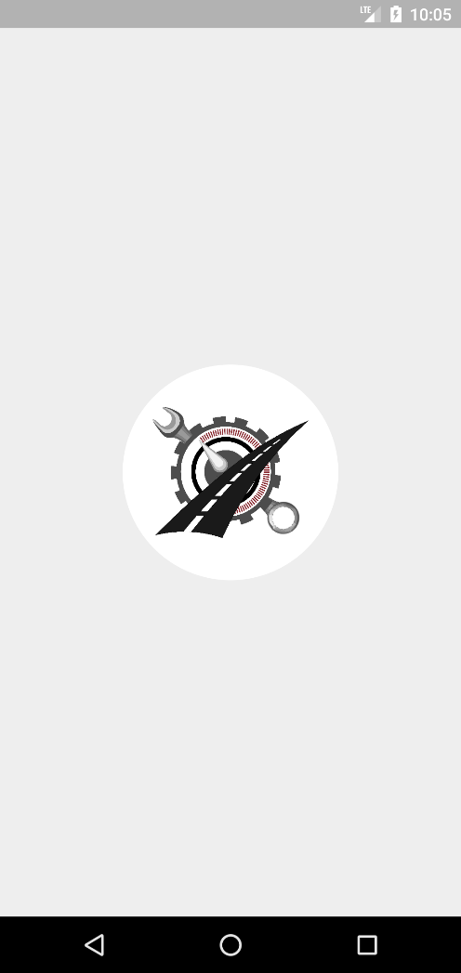
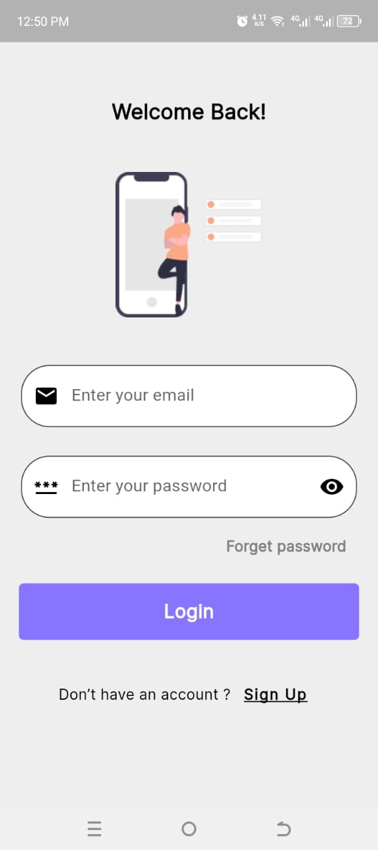
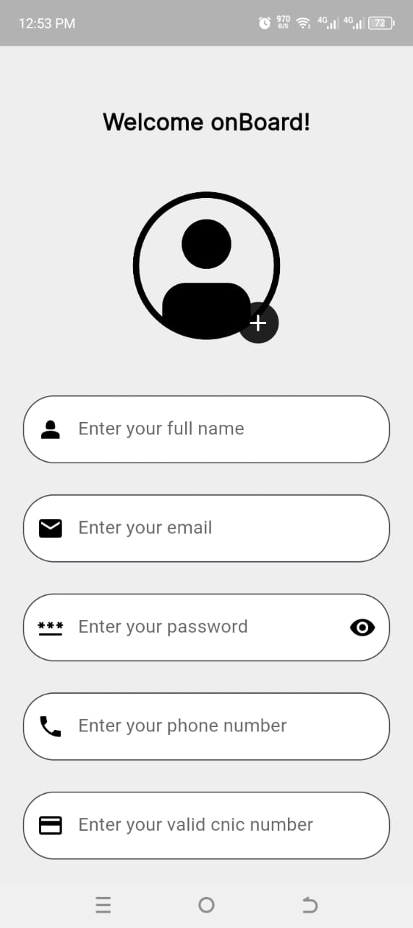
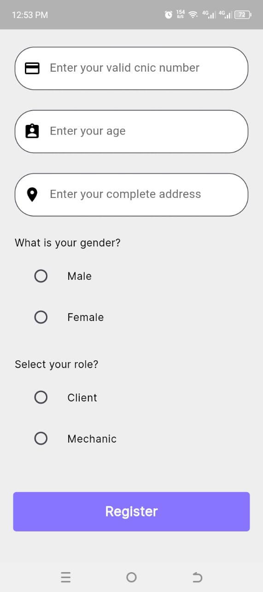
Screenshot:
Splash Screen
Login Screen
Signup Screen
Signup Screen

Slide 8
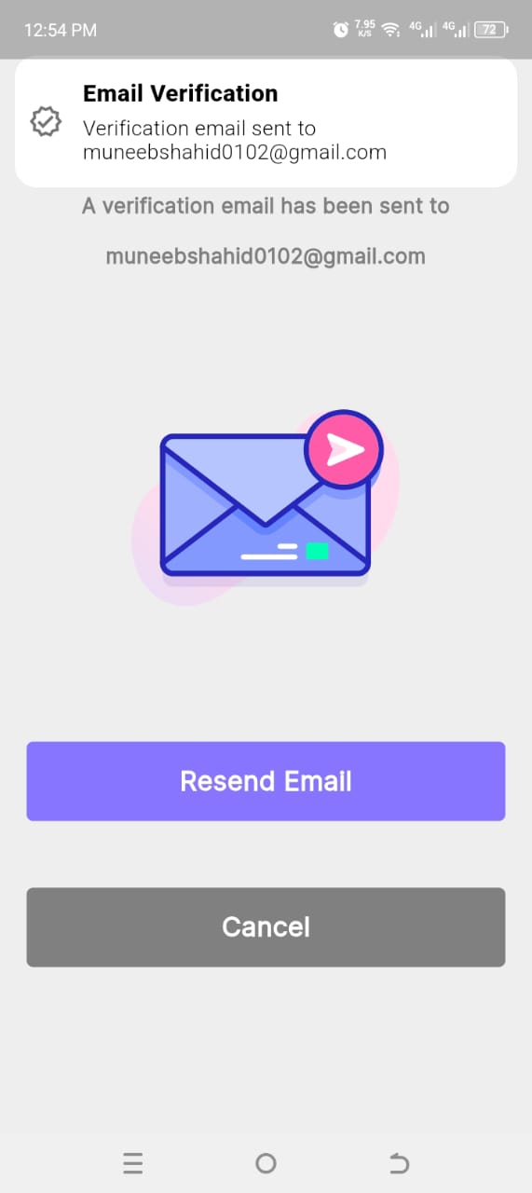
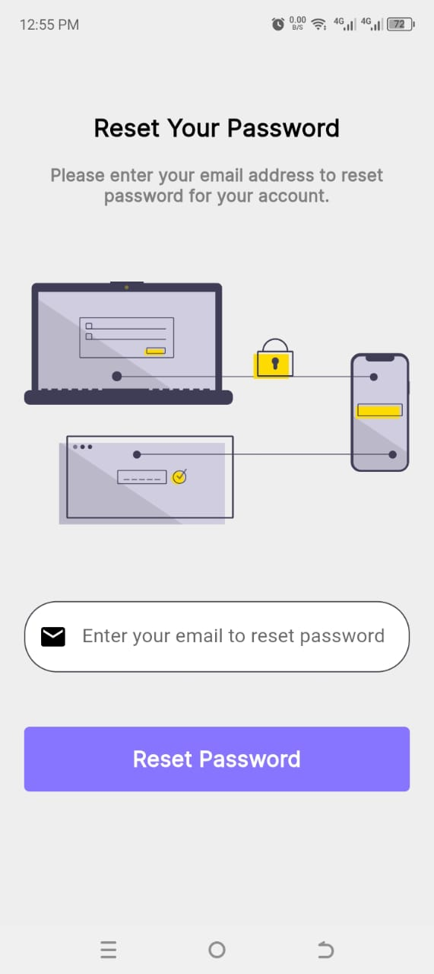
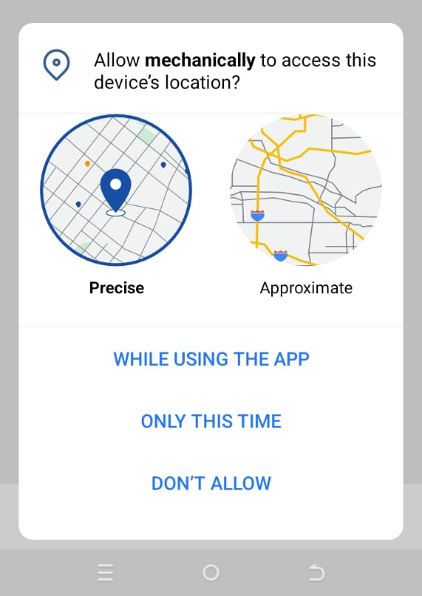
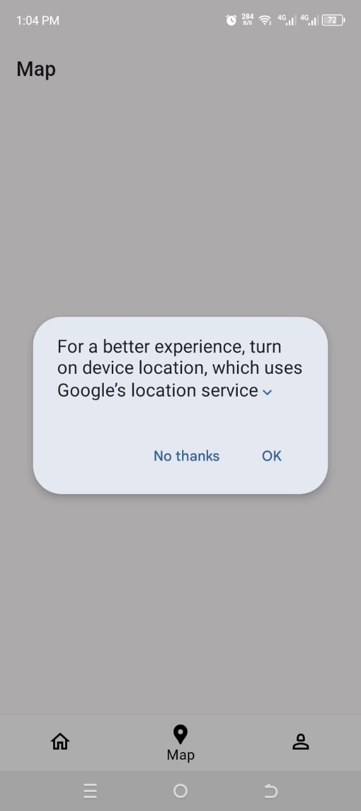
Cont..
Email Verification Screen
Reset Password Screen
Location Permission Screen
Location Permission Screen

Slide 9
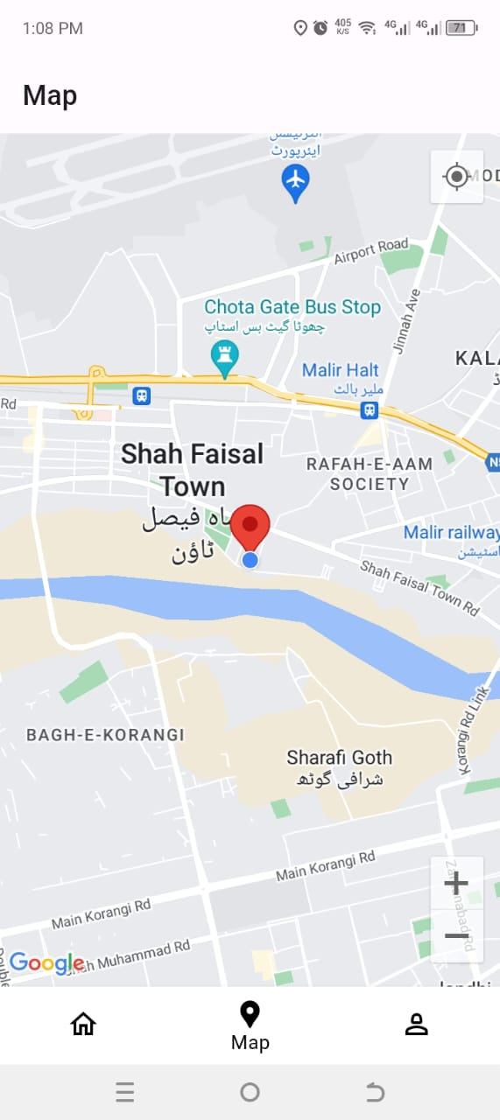
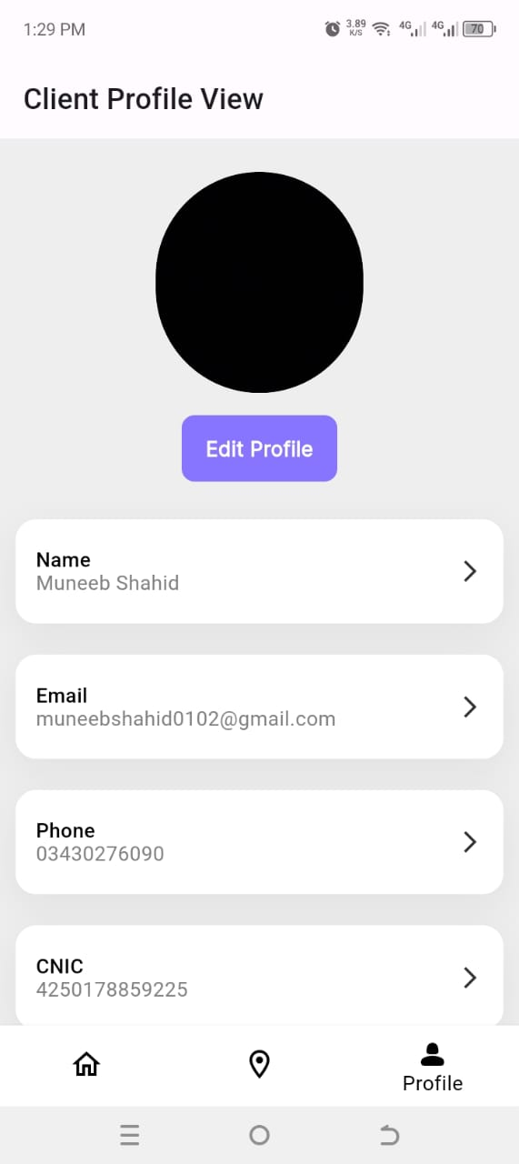
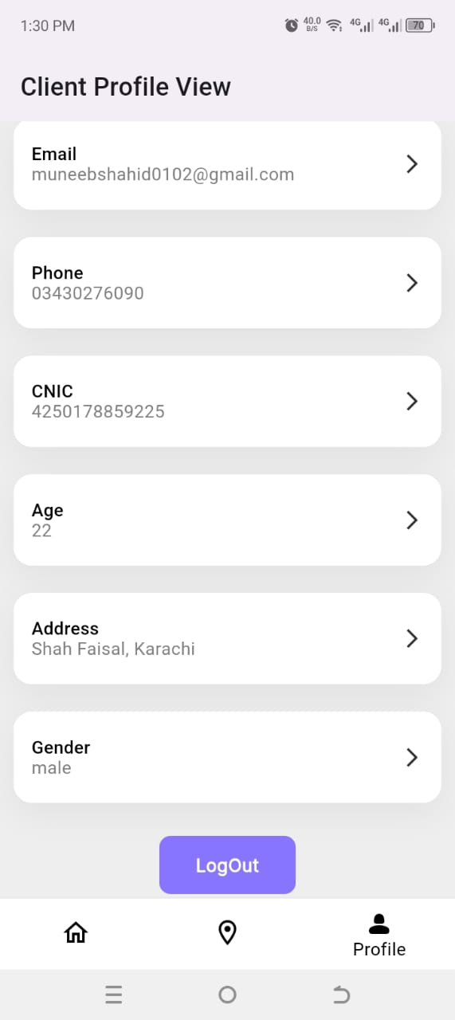
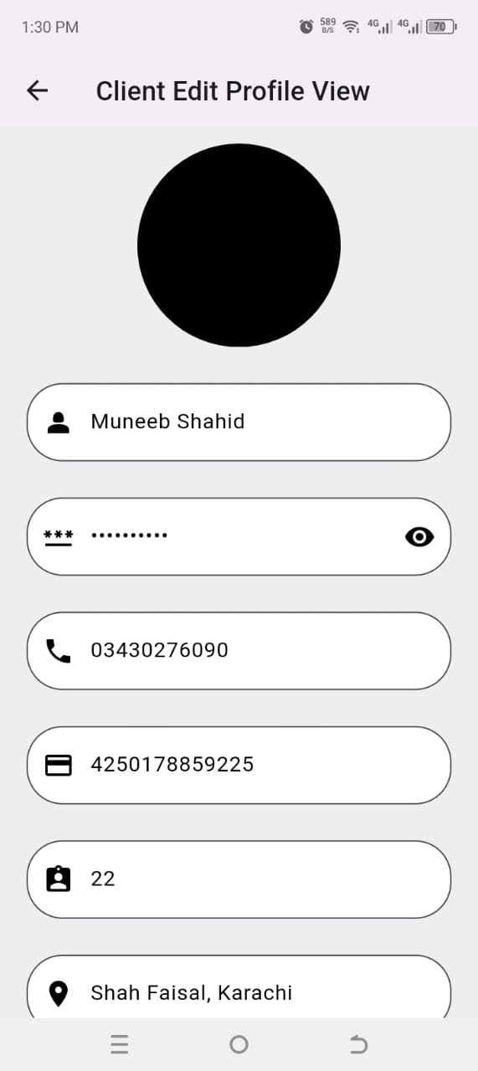
Cont..
Google Map Screen
Profile Screen
Profile Screen
Edit Profile
Screen

Slide 10
App Build Video Link:
https://drive.google.com/drive/folders/1E8K9HAr_J2nmVDPYIxgW3qaCYuV1ku6_?usp=drive_link
App Code Link:
https://github.com/muneeb-shahid/Mechanically-Final-Year-Project

Slide 11
Future Work
1) Implementing local notification and push notification in both the client and mechanic modules.
2) Integrating Google Maps, where the user's current location is obtained using LATLNG.
3) Displaying the location on Google Maps in both the client and mechanic modules.
4) Constructing the Google Maps screen in both the client and mechanic modules.
5) Complete all necessary development tasks to ensure the app is fully functional by the next update.
6) Generate the Android APK build.

Slide 12



Suggestions and Questions

